Slide 1
Chapter 16 Ajax
簡廷因 Ting-Ying Chien
2024.12.18

Slide 2
Outline
Introduction
jQuery Ajax
“Raw” Ajax Example Using the XMLhttpRequest Object

Slide 3
Introduction
Ajax applications separate client-side user interaction and server communication, and run them in parallel, making the delays of server-side processing more transparent to the user
“Raw” Ajax uses JavaScript to send asynchronous requests to the server, then updates the page using the DOM
When writing “raw” Ajax you need to deal directly with cross-browser portability issues, making it impractical for developing large-scale applications

Slide 4
Introduction
Client-side of Ajax applications
Written in HTML5 and CSS3
Uses JavaScript to add functionality to the user interface
XML and JSON are used to structure the data passed between the server and the client
XMLHttpRequest
The Ajax component that manages interaction with the server

Slide 5
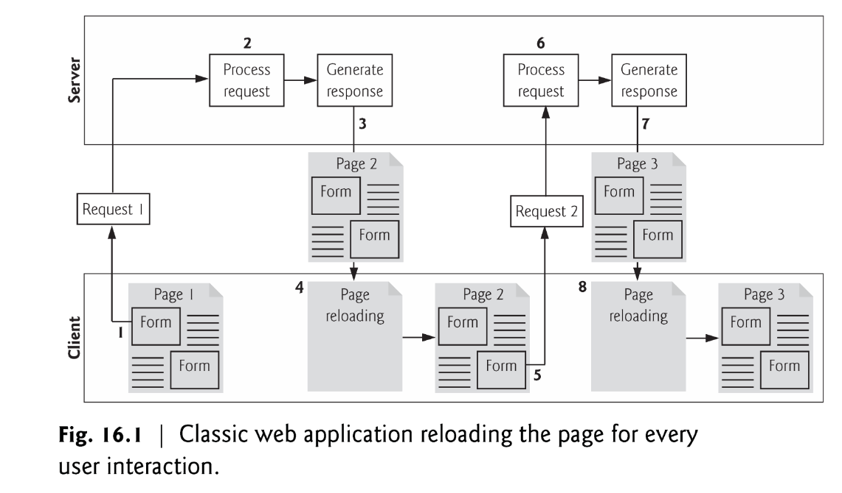
Introduction
Traditional web applications
While a synchronous request is being processed on the server, the user cannot interact with the client web browser
Client waits for the server to respond and reloads the entire page with the data from the response

Slide 6
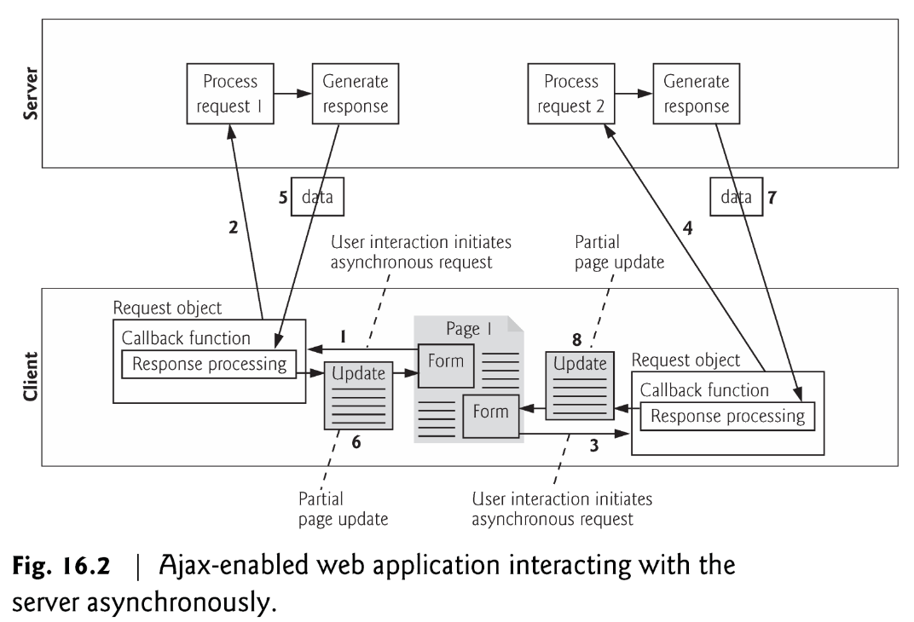
Introduction
Ajax Web Applications
Callback function updates only a designated part of the page
Partial page updates help make web applications more responsive, making them feel more like desktop applications

Slide 7
jQuery Ajax

Slide 8
Introduction
jQuery is a fast, small, and feature-rich JavaScript library. It makes things like HTML document traversal and manipulation, event handling, animation, and Ajax much simpler with an easy-to-use API that works across a multitude of browsers.

Slide 9

jQuery Ajax + PHP
<!DOCTYPE html>
<html>
<head>
<meta charset = "utf-8">
<title>jQuery Ajax and PHP</title>
<script src="//code.jquery.com/jquery-2.1.4.min.js"></script>
<script>
function start()
{
var id = window.prompt( "Please enter your ID" );
$.ajax({
url: "test.php",
data: {
name: id
},
type: "POST",
datatype: "html",
success: function( output ) {
document.getElementById( "out" ).innerHTML = output;
},
error : function(){
alert( "Request failed." );
}
});
}
window.addEventListener( "load", start, false );
</script>
</head>
<body>
<div id="out"></div>
</body>
</html>
url:將資料傳到哪個位置
data:傳送的變數
type:傳送的方式 (GET/POST)
dataType:資料回傳的格式(html/script/json/xml)
success: 抓取資料成功後做的事
error: 抓取資料失敗後做的事
<?php
$name = $_POST["name"];
print ("<p>Hello, $name</p>");
?>
test.php

Slide 10
jQuery Ajax + PHP
<!DOCTYPE html>
<html>
<head>
<meta charset = "utf-8">
<title>jQuery Ajax and PHP</title>
<script src="//code.jquery.com/jquery-2.1.4.min.js"></script>
<script>
$(function(){
var id = window.prompt( "Please enter your ID" );
$.ajax({
url: "test.php",
data: {
name: id
},
type: "POST",
datatype: "html",
success: function( output ) {
$( "#out" ).html(output);
},
error : function(){
alert( "Request failed." );
}
});
});
</script>
</head>
<body>
<div id="out"></div>
</body>
</html>
<?php
$name = $_POST["name"];
print ("<p>Hello, $name</p>");
?>
test.php

Slide 11

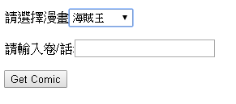
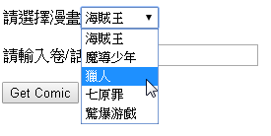
Exercise
Get comic automatically
jQuery Ajax + PHP
var cid = $("#cid").val();
var vol = $("#vol").val();
function urlexist ($url)
{
$headers = @get_headers($url);
if(strpos($headers[0],'404') === false)
{ return true;}
else { return false;}
}

Slide 12
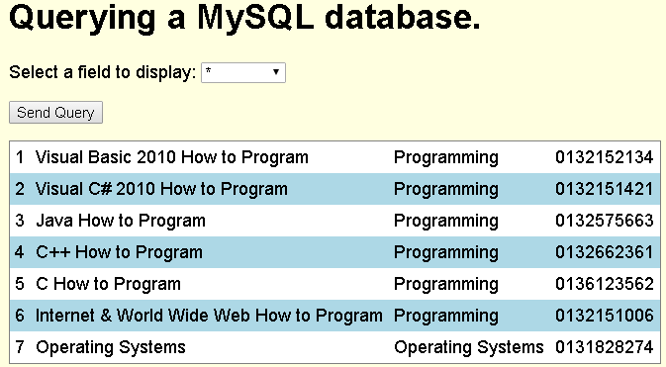
jQuery Ajax + PHP + MySQL
<!DOCTYPE html>
<html>
<head>
<meta charset = "utf-8">
<title>Sample Database Query</title>
<script src="//code.jquery.com/jquery-2.1.4.min.js"></script>
<script>
function progress() {
var sel = $("#select").val();
$.ajax({
url: "database.php",
data: {
select: sel
},
type: "POST",
datatype: "html",
success: function( output ) {
$( "#out" ).html(output);
},
error : function(){
alert( "Request failed." );
}
});
}
</script>
<style type = "text/css">
body { font-family: sans-serif;
background-color: lightyellow; }
table { background-color: lightblue;
border-collapse: collapse;
border: 1px solid gray; }
td { padding: 5px; }
tr:nth-child(odd) { background-color: white; }
</style>
</head>

Slide 13
jQuery Ajax + PHP5 + MySQL
<body>
<h1>Querying a MySQL database.</h1>
<form method = "post" action = "#">
<p>Select a field to display:
<select id = "select">
<option selected>*</option>
<option>ID</option>
<option>Title</option>
<option>Category</option>
<option>ISBN</option>
</select></p>
<p><input id = "submit" type="button" value = "Send Query" onclick="progress()"></p>
</form>
<div id="out"></div>
</body>
</html>

Slide 14
jQuery Ajax + PHP5 + MySQL
database.php
<?php
$select = $_POST["select"];
$query = "SELECT " . $select . " FROM books";
if ( !( $database = mysql_connect( "localhost", "USERID", "password" ) ) )
die( "Could not connect to database </body></html>" );
if ( !mysql_select_db( "products", $database ) )
die( "Could not open products database </body></html>" );
if ( !( $result = mysql_query( $query, $database ) ) )
{
print( "<p>Could not execute query!</p>" );
die( mysql_error() . "</body></html>" );
}
mysql_close( $database );
print ("<table>");
while ( $row = mysql_fetch_row( $result ) )
{
print( "<tr>" );
foreach ( $row as $value )
print( "<td>$value</td>" );
print( "</tr>" );
}
print ("</table>");
?>

Slide 15
jQuery Ajax + PHP7 + MySQL
PHP7
database.php
<?php
$select = $_POST["select"];
$query = "SELECT " . $select . " FROM books";
if ( !( $database = mysqli_connect( "localhost", "USERID", "password" ) ) )
die( "Could not connect to database </body></html>" );
if ( !mysqli_select_db($database,"products" ) )
die( "Could not open products database </body></html>" );
if ( !( $result = mysqli_query($database, $query) ) )
{
print( "<p>Could not execute query!</p>" );
die( mysqli_error() . "</body></html>" );
}
mysqli_close( $database );
print ("<table>");
while ( $row = mysqli_fetch_row( $result ) )
{
print( "<tr>" );
foreach ( $row as $value )
print( "<td>$value</td>" );
print( "</tr>" );
}
print ("</table>");
?>

Slide 16
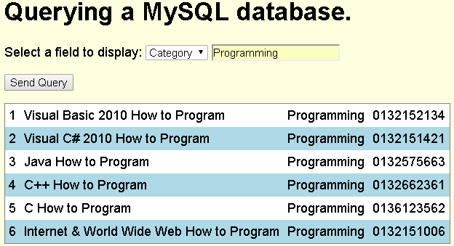
Exercise
Ref : ch19.v1.pptx p41

Slide 17
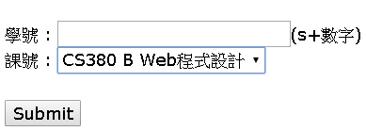
Exercise
簽到系統
Hint :
$today = date("Ymd");
$ip=$_SERVER['REMOTE_ADDR']

Slide 18
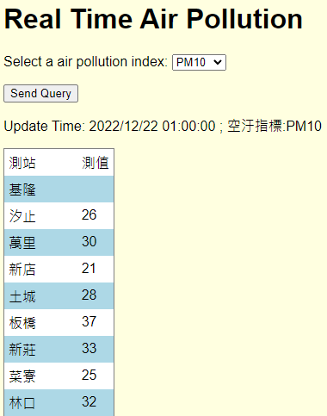
jQuery Ajax + PHP + CSV
<!DOCTYPE html>
<html>
<head>
<meta charset = "utf-8">
<title>Sample CSV Query</title>
<script src="//code.jquery.com/jquery-2.1.4.min.js"></script>
<script>
function progress() {
var aq = $("#aqindex").val();
$.ajax({
url: "csv.php",
data: {
aq: aq
},
type: "POST",
datatype: "html",
success: function( output ) {
$( "#out" ).html(output);
},
error : function(){
alert( "Request failed." );
}
});
}
</script>
<style type = "text/css">
body { font-family: sans-serif;
background-color: lightyellow; }
table { background-color: lightblue;
border-collapse: collapse;
border: 1px solid gray; }
td { padding: 5px; }
tr:nth-child(odd) { background-color: white; }
</style>
</head>

Slide 19
jQuery Ajax + PHP + CSV
<body>
<h1>Real Time Air Pollution</h1>
<form method = "post" action = "#">
<p>Select a air pollution index:
<select id = "aqindex">
<option selected>AQI</option>
<option>SO2</option>
<option>CO</option>
<option>O3</option>
<option>PM10</option>
<option>PM2.5</option>
<option>NO2</option>
</select></p>
<p><input id = "submit" type="button" value = "Send Query" onclick="progress()"></p>
</form>
<div id="out"></div>
</body>
</html>

Slide 20
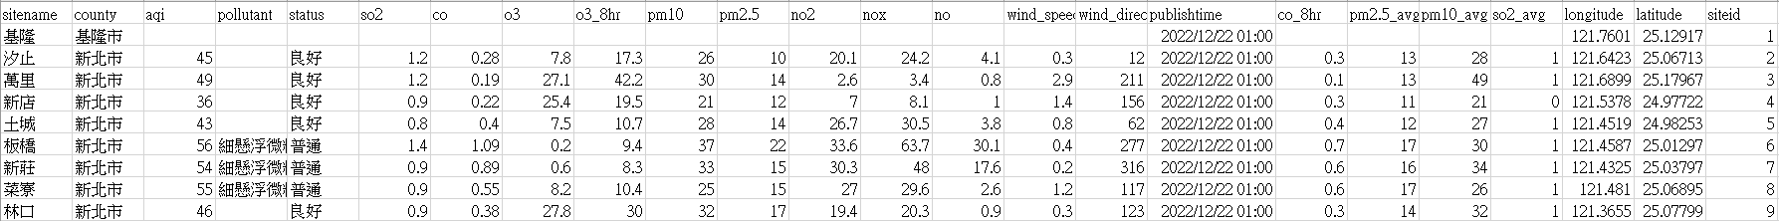
jQuery Ajax + PHP + CSV
<?php
$aq = $_POST["aq"];
$data = file_get_contents('https://data.moenv.gov.tw/api/v2/aqx_p_432?api_key=e8dd42e6-9b8b-43f8-991e-b3dee723a52d&limit=1000&format=CSV');
$rows = explode("\n",$data);
$s = array();
$num=0;
foreach($rows as $row) {
$s[] = str_getcsv($row);
$num++;
}
$time = $s[3][16];
print ("<p>Update Time: $time ; 空汙指標:$aq</p>");
$index =0;
switch ($aq)
{
case "AQI":$index=2;break;
case "SO2":$index=5;break;
case "CO":$index=6;break;
case "O3":$index=7;break;
case "PM10":$index=9;break;
case "PM2.5":$index=10;break;
case "NO2":$index=11;break;
}
print ("<table><tr><td>測站</td><td>測值</td></tr>");
for ($i=3;$i<$num-1;$i++)
{
$station = $s[$i][0];
$value = $s[$i][$index];
print ("<tr><td>$station</td><td>$value</td></tr>");
}
print ("</table>");
?>

Slide 21
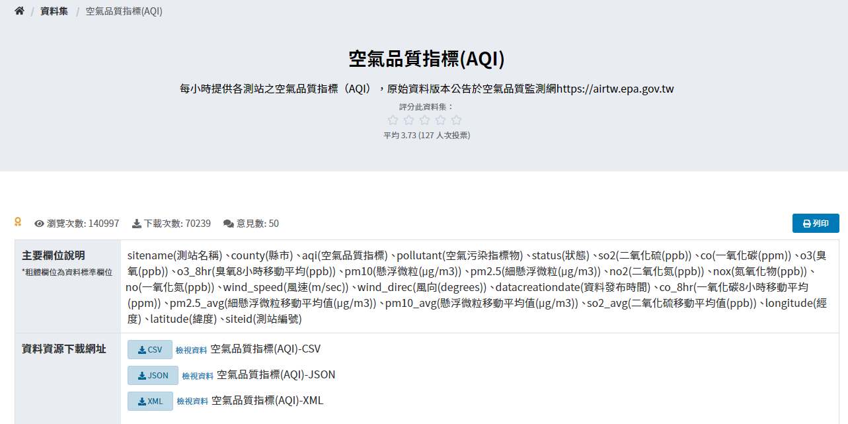
jQuery Ajax + PHP + CSV
Open Data
https://data.gov.tw/dataset/40448

Slide 22
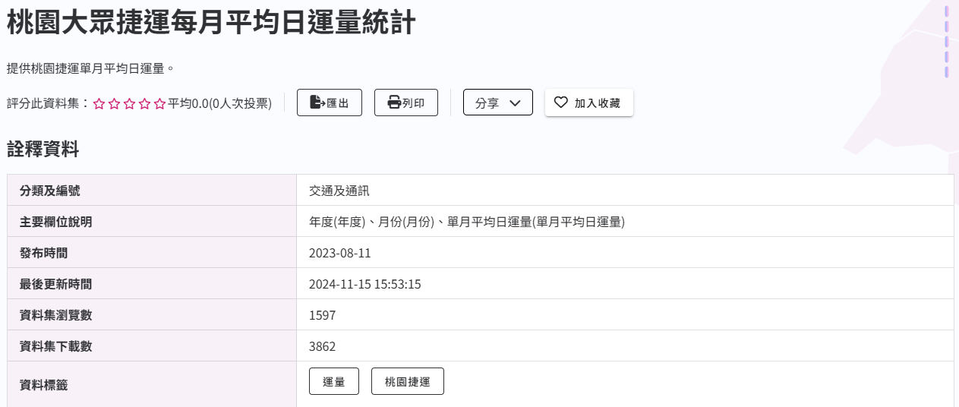
Exercise
依使用者選擇年度, 列出該年度機場捷運單月平均日運量
Data:
https://opendata.tycg.gov.tw/datalist/1a51d61b-d040-47c2-9300-9a19d99a46a4
https://opendata.tycg.gov.tw/api/v1/dataset.api_access?rid=06f878b6-92e3-4b63-9960-1210d12fd27e&format=csv

Slide 23
XML

Slide 24
Introduction
XML stands for EXtensible Markup Language
XML is a markup language much like HTML
XML was designed to store and transport data
Ajax applications often use XML because it consumes little bandwidth and is easy to parse

Slide 25
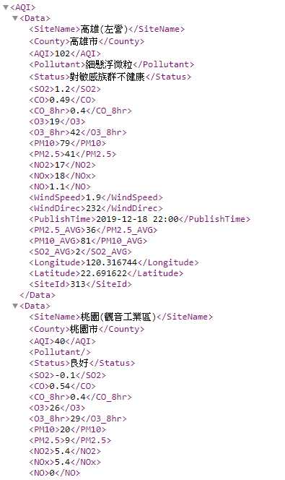
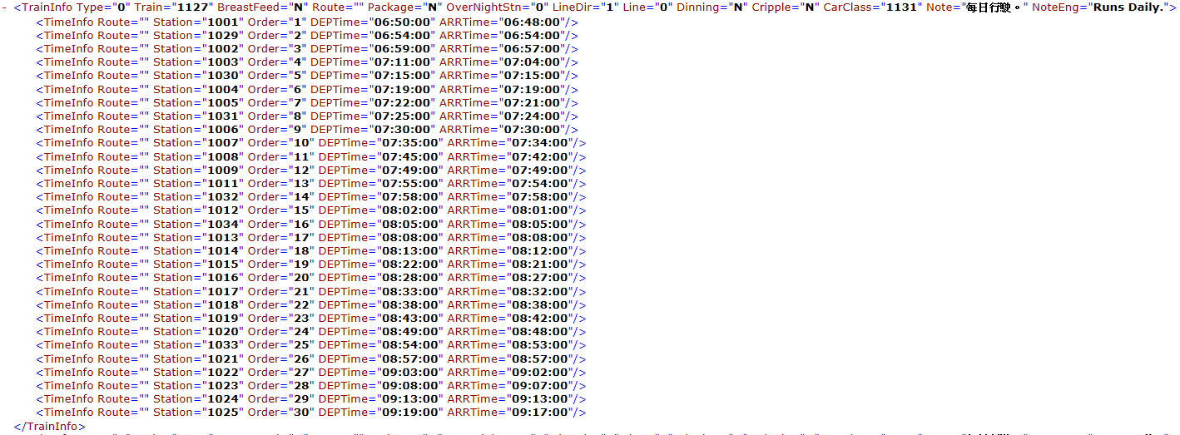
Introduction
start tag
Tag
Element
Attribute
end tag
empty-element tag

Slide 26
jQuery Ajax + XML
<!DOCTYPE html>
<html>
<head>
<meta charset="utf-8">
<title> Pulling Images onto the Page </title>
<script src="//code.jquery.com/jquery-2.1.4.min.js"></script>
<style type = "text/css">
li { display: inline-block; padding: 4px; width: 120px; }
img { border: 1px solid black }
</style>
<script>
function getImages( url )
{
$.ajax({
url: url,
type: "GET",
datatype: "xml",
success: function( xml ) {
clearImages();
var output = document.getElementById( "covers" );
var imagesUL = document.createElement( "ul" );
var baseUrl = $(xml).find("baseurl").text();
$(xml).find("cover").each(function(){
var image = $(this).children('image').text();
var imageLI = document.createElement( "li" );
var imageTag = document.createElement( "img" );
imageTag.setAttribute( "src", baseUrl + escape( image ) );
imageLI.appendChild( imageTag );
imagesUL.appendChild( imageLI );
});
output.appendChild( imagesUL );
},
error : function(){
alert( "Request failed." );
}
});
}

Slide 27
jQuery Ajax + XML
function clearImages()
{
document.getElementById( "covers" ).innerHTML = "";
}
function registerListeners()
{
document.getElementById( "all" ).addEventListener("click",
function() { getImages( "all.xml" ); }, false );
document.getElementById( "simply" ).addEventListener("click",
function() { getImages( "simply.xml" ); }, false );
document.getElementById( "howto" ).addEventListener("click",
function() { getImages( "howto.xml" ); }, false );
document.getElementById( "dotnet" ).addEventListener("click",
function() { getImages( "dotnet.xml" ); }, false );
document.getElementById( "javaccpp" ).addEventListener("click",
function() { getImages( "javaccpp.xml" ); }, false );
document.getElementById( "none" ).addEventListener("click", clearImages, false );
}
window.addEventListener( "load", registerListeners, false );
</script>
</head>

Slide 28
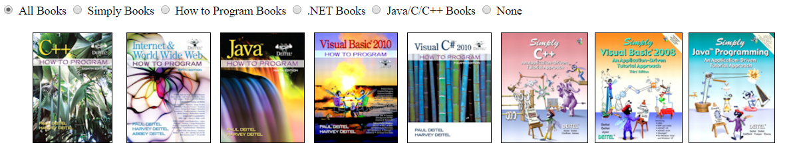
jQuery Ajax + XML
<body>
<input type = "radio" name ="Books" value = "all" id = "all"> All Books
<input type = "radio" name = "Books" value = "simply" id = "simply"> Simply Books
<input type = "radio" name = "Books" value = "howto" id = "howto"> How to Program Books
<input type = "radio" name = "Books" value = "dotnet" id = "dotnet"> .NET Books
<input type = "radio" name = "Books" value = "javaccpp" id = "javaccpp"> Java/C/C++ Books
<input type = "radio" checked name = "Books" value = "none" id = "none"> None
<div id = "covers"></div>
</body>
</html>

Slide 29
jQuery Ajax + XML
<!DOCTYPE html>
<html>
<head>
<meta charset = "utf-8">
<title>Sample CSV Query</title>
<script src="//code.jquery.com/jquery-2.1.4.min.js"></script>
<script>
function progress() {
var aq = $("#aqindex").val();
$.ajax({
url: "AQX.xml",
type: "GET",
datatype: "xml",
success: function( xml ) {
var output = document.getElementById( "out" );
$(xml).find("Data").each(function(){
var row = document.createElement( "tr" );
var station = document.createTextNode($(this).children("SiteName").text());
var value = document.createTextNode($(this).children(aq).text());
var c1 = document.createElement( "td");
c1.appendChild(station);
row.appendChild( c1);
var c2 = document.createElement( "td");
c2.appendChild(value);
row.appendChild( c2);
output.appendChild( row );
});
},
error : function(){
alert( "Request failed." );
}
});
}
</script>

Slide 30
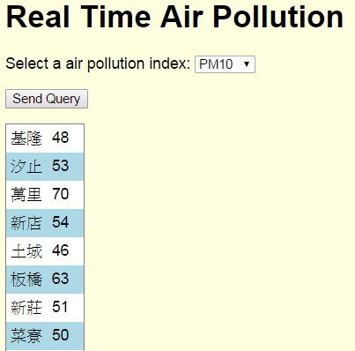
jQuery Ajax + XML
<style type = "text/css">
body { font-family: sans-serif;
background-color: lightyellow; }
table { background-color: lightblue;
border-collapse: collapse;
border: 1px solid gray; }
td { padding: 5px; }
tr:nth-child(odd) { background-color: white; }
</style>
</head>
<body>
<h1>Real Time Air Pollution</h1>
<form method = "post" action = "#">
<p>Select a air pollution index:
<select id = "aqindex">
<option selected>AQI</option>
<option>SO2</option>
<option>CO</option>
<option>O3</option>
<option>PM10</option>
<option>PM2.5</option>
<option>NO2</option>
</select></p>
<p><input id = "submit" type="button" value = "Send Query" onclick="progress()"></p>
</form>
<table id="out"></table>
</body>
</html>

Slide 31
Cross-origin resource sharing (CORS)
No 'Access-Control-Allow-Origin' header is present on the requested resource. ERROR
Same-origin policy
a security measure implemented in browsers to restrict interaction between documents (or scripts) that have different origins
Solution
Cross-origin resource sharing (CORS)
url: "AQX.xml"
change to
url: "https://data.moenv.gov.tw/api/v2/aqx_p_432?api_key=e8dd42e6-9b8b-43f8-991e-b3dee723a52d&limit=1000&format=CSV"

Slide 32
Cross-origin resource sharing (CORS)
Method 1 :
Apache
Header set Access-Control-Allow-Origin "*"
Method 2 :
php
header("Access-Control-Allow-Origin: *");
ref : http://enable-cors.org/server.html

Slide 33
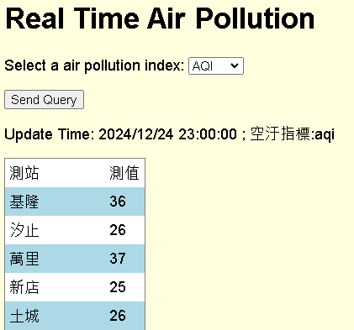
jQuery Ajax + PHP + XML
<!DOCTYPE html>
<html>
<head>
<meta charset = "utf-8">
<title>Sample XML Query</title>
<script src="//code.jquery.com/jquery-2.1.4.min.js"></script>
<script>
function progress() {
var aq = $("#aqindex").val();
$.ajax({
url: "xml.php",
data: {
aq: aq
},
type: "POST",
datatype: "html",
success: function( output ) {
$( "#out" ).html(output);
},
error : function(){
alert( "Request failed." );
}
});
}
</script>
<style type = "text/css">
body { font-family: sans-serif;
background-color: lightyellow; }
table { background-color: lightblue;
border-collapse: collapse;
border: 1px solid gray; }
td { padding: 5px; }
tr:nth-child(odd) { background-color: white; }
</style>
</head>

Slide 34
jQuery Ajax + PHP + XML
<body>
<h1>Real Time Air Pollution</h1>
<form method = "post" action = "#">
<p>Select a air pollution index:
<select id = "aqindex">
<option selected>AQI</option>
<option>SO2</option>
<option>CO</option>
<option>O3</option>
<option>PM10</option>
<option>PM2.5</option>
<option>NO2</option>
</select></p>
<p><input id = "submit" type="button" value = "Send Query" onclick="progress()"></p>
</form>
<div id="out"></div>
</body>
</html>

Slide 35
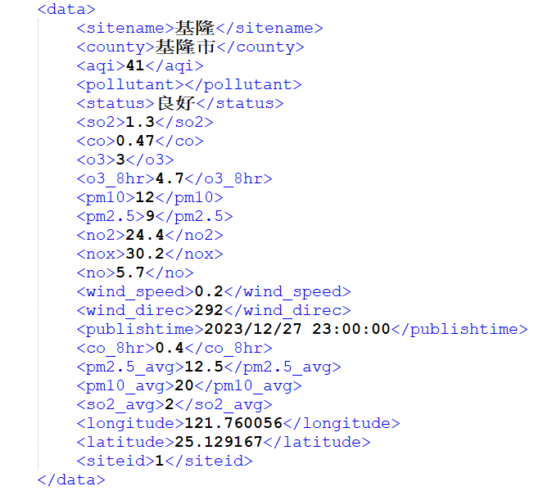
jQuery Ajax + PHP + XML
<?php
$aq = $_POST["aq"];
$aq = strtolower($aq);
header("Access-Control-Allow-Origin: *");
$context = stream_context_create(array('http' => array('header' => 'Accept: application/xml')));
$url = "https://data.moenv.gov.tw/api/v2/aqx_p_432?api_key=e8dd42e6-9b8b-43f8-991e-b3dee723a52d&limit=1000&format=XML" ;
$xml = file_get_contents($url, false, $context);
$xml = simplexml_load_string($xml);
$time = $xml->data->publishtime;
print ("<p>Update Time: $time ; 空汙指標:$aq</p>");
print ("<table><tr><td>測站</td><td>測值</td></tr>");
foreach ($xml->data as $key)
{
$station = $key->sitename;
$value = $key->{$aq};
print ("<tr><td>$station</td><td>$value</td></tr>");
}
print ("</table>");
?>

Slide 36
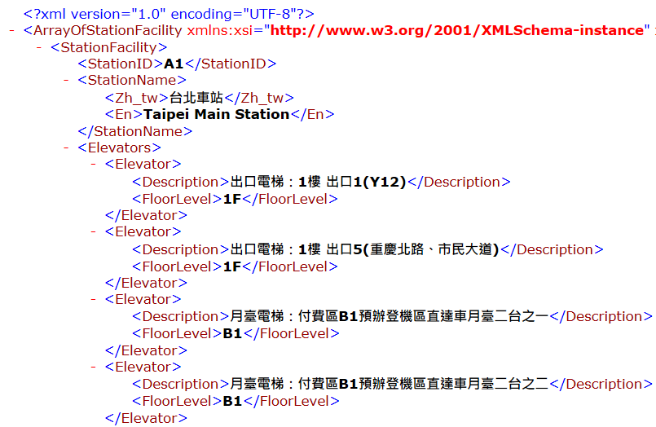
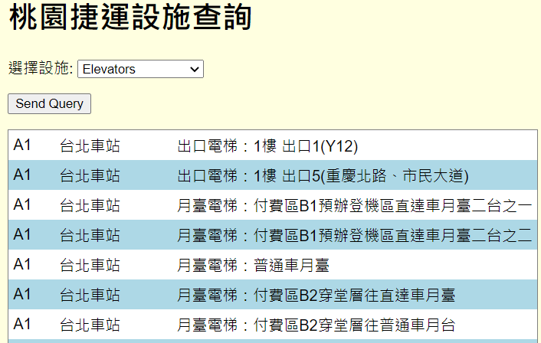
Exercise
桃園捷運車站設施資料
https://data.tycg.gov.tw/opendata/datalist/datasetMeta/resource?oid=024588d8-ad45-410e-966d-91caa8708599&rid=0aa8b321-9d6e-48a6-a320-8a4a6bb6c692

Slide 37
JSON

Slide 38
Introduction
JSON (JavaScript Object Notation)
Simple way to represent JavaScript objects as strings
A simpler alternative to XML for passing data between the client and the server
JSON object
Represented as a list of property names and values contained in curly braces
Array
Represented in JSON with square brackets containing a comma-separated list of values
Each value in a JSON array can be a string, a number, a JSON representation of an object, true, false or null
JSON strings
Easier to create and parse than XML
Require fewer bytes
For these reasons, JSON is commonly used to communicate in client/server interaction

Slide 39
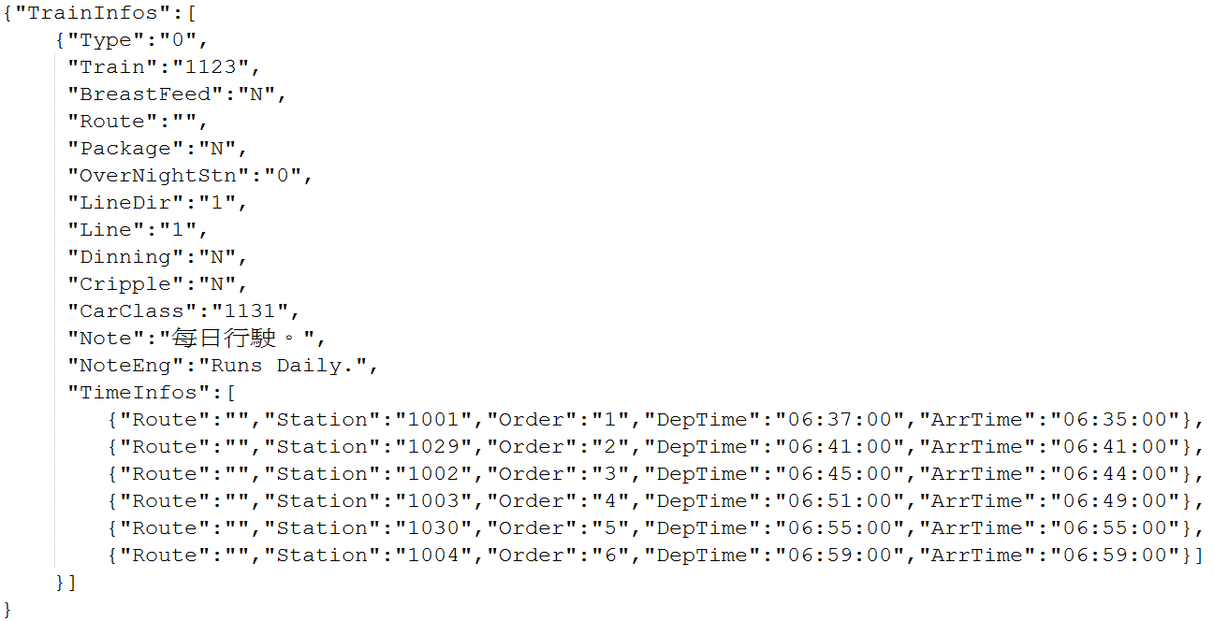
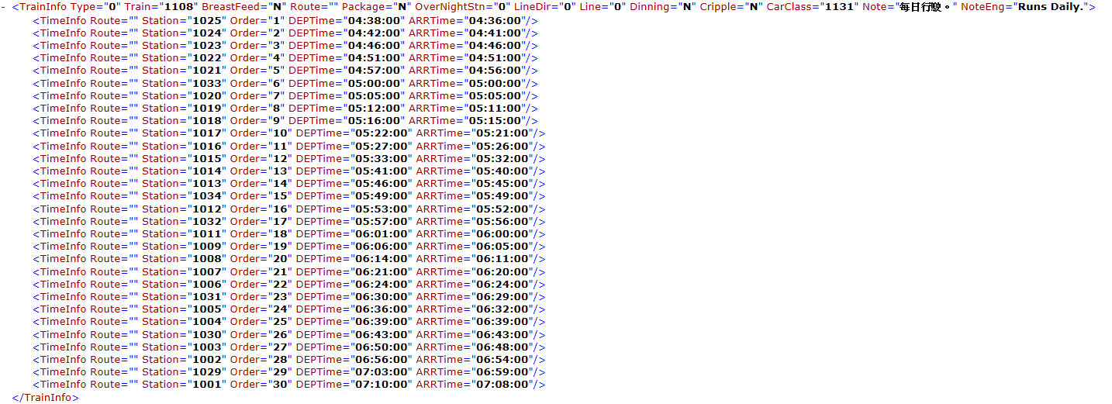
Introduction
JSON v.s XML

Slide 40
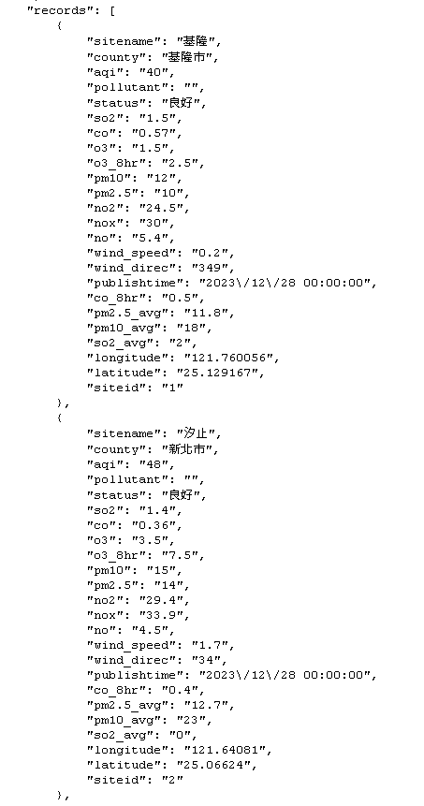
JQuery Ajax+ JSON
<!DOCTYPE html>
<html>
<head>
<meta charset = "utf-8">
<title>Sample CSV Query</title>
<script src="//code.jquery.com/jquery-2.1.4.min.js"></script>
<script>
function progress() {
var aq = $("#aqindex").val();
$.ajax({
url: "AQX.json",
type: "GET",
datatype: "json",
success: function( data ) {
var output = document.getElementById( "out" );
$.each(data.records,function(i,item){
var row = document.createElement( "tr" );
var station = document.createTextNode(item["SiteName"]);
var value = document.createTextNode(item[aq]);
var c1 = document.createElement( "td");
c1.appendChild(station);
row.appendChild( c1);
var c2 = document.createElement( "td");
c2.appendChild(value);
row.appendChild( c2);
output.appendChild( row );
});
},
error : function(){
alert( "Request failed." );
}
});
}
</script>
i : 紀錄迴圈次數
item : 存放指標

Slide 41
jQuery Ajax + JSON
<style type = "text/css">
body { font-family: sans-serif;
background-color: lightyellow; }
table { background-color: lightblue;
border-collapse: collapse;
border: 1px solid gray; }
td { padding: 5px; }
tr:nth-child(odd) { background-color: white; }
</style>
</head>
<body>
<h1>Real Time Air Pollution</h1>
<form method = "post" action = "#">
<p>Select a air pollution index:
<select id = "aqindex">
<option selected>AQI</option>
<option>SO2</option>
<option>CO</option>
<option>O3</option>
<option>PM10</option>
<option>PM2.5</option>
<option>NO2</option>
</select></p>
<p><input id = "submit" type="button" value = "Send Query" onclick="progress()"></p>
</form>
<table id="out"></table>
</body>
</html>

Slide 42
jQuery Ajax + PHP + JSON
<!DOCTYPE html>
<html>
<head>
<meta charset = "utf-8">
<title>Sample JSON Query</title>
<script src="//code.jquery.com/jquery-2.1.4.min.js"></script>
<script>
function progress() {
var aq = $("#aqindex").val();
$.ajax({
url: "json.php",
data: {
aq: aq
},
type: "POST",
datatype: "html",
success: function( output ) {
$( "#out" ).html(output);
},
error : function(){
alert( "Request failed." );
}
});
}
</script>
<style type = "text/css">
body { font-family: sans-serif;
background-color: lightyellow; }
table { background-color: lightblue;
border-collapse: collapse;
border: 1px solid gray; }
td { padding: 5px; }
tr:nth-child(odd) { background-color: white; }
</style>
</head>

Slide 43
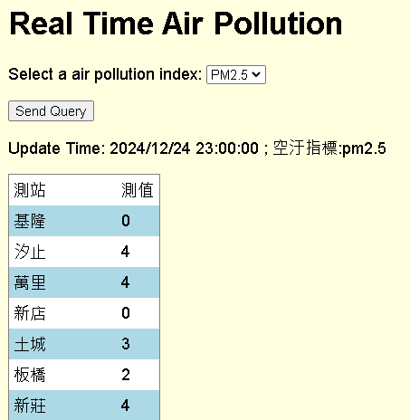
jQuery Ajax + PHP + JSON
<body>
<h1>Real Time Air Pollution</h1>
<form method = "post" action = "#">
<p>Select a air pollution index:
<select id = "aqindex">
<option selected>AQI</option>
<option>SO2</option>
<option>CO</option>
<option>O3</option>
<option>PM10</option>
<option>PM2.5</option>
<option>NO2</option>
</select></p>
<p><input id = "submit" type="button" value = "Send Query" onclick="progress()"></p>
</form>
<div id="out"></div>
</body>
</html>

Slide 44
jQuery Ajax + PHP + JSON
<?php
header("Access-Control-Allow-Origin: *");
$aq = $_POST["aq"];
$aq = strtolower($aq);
$context = stream_context_create(array('http' => array('header' => 'Accept: application/json')));
$url = "https://data.moenv.gov.tw/api/v2/aqx_p_432?api_key=e8dd42e6-9b8b-43f8-991e-b3dee723a52d&limit=1000&format=json" ;
$data = file_get_contents($url, false, $context);
$data = json_decode($data);
$time = $data->records[0]->publishtime;
print ("<p>Update Time: $time ; 空汙指標:$aq</p>");
print ("<table><tr><td>測站</td><td>測值</td></tr>");
foreach ($data->records as $key)
{
$station = $key->{"sitename"};
$value = $key->{$aq};
print ("<tr><td>$station</td><td>$value</td></tr>");
}
print ("</table>");
?>

Slide 45
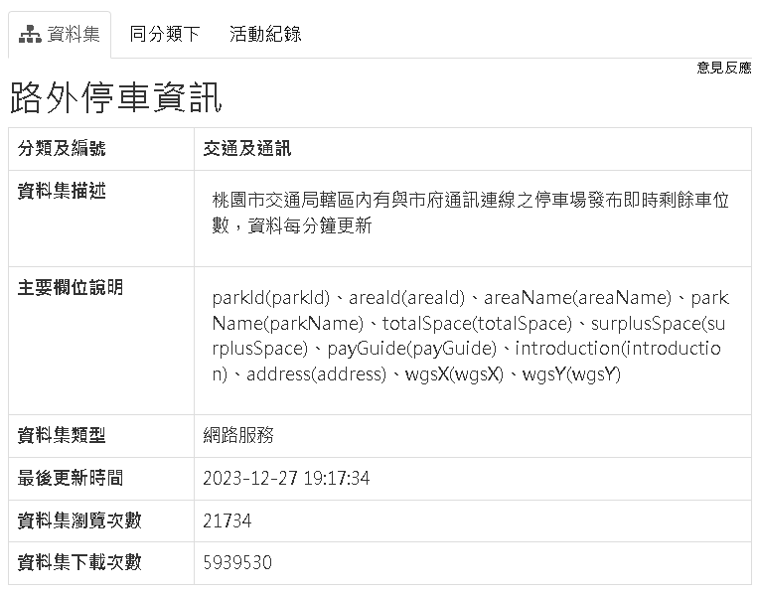
Exercise
列出桃園市某行政區停車場資訊
https://data.tycg.gov.tw/opendata/datalist/datasetMeta/download?id=f4cc0b12-86ac-40f9-8745-885bddc18f79&rid=0daad6e6-0632-44f5-bd25-5e1de1e9146f

Slide 46
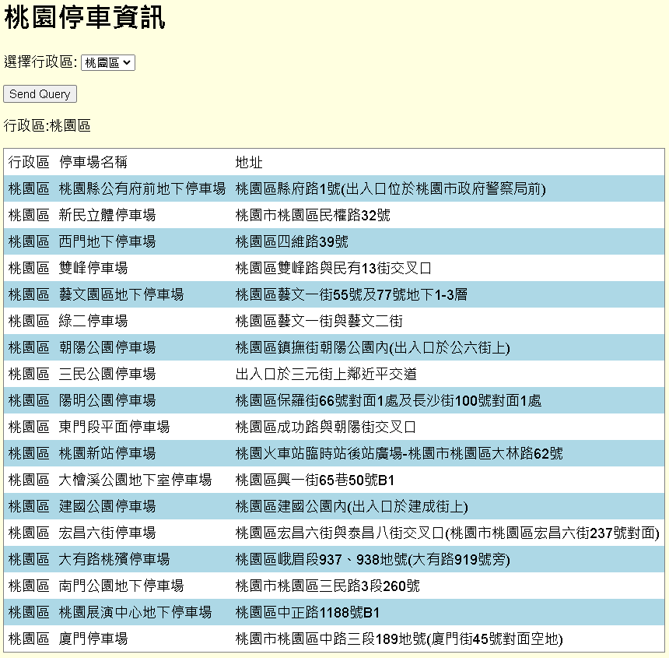
Exercise

Slide 47
Q&A

Slide 48
Appendix

Slide 49
“Raw” Ajax Example Using the XMLhttpRequest Object
<!DOCTYPE html>
<html>
<head>
<meta charset = "utf-8">
<style type = "text/css">
.box { border: 1px solid black; padding: 10px }
</style>
<title>Switch Content Asynchronously</title>
<script>
var asyncRequest; // variable to hold XMLHttpRequest object
function registerListeners()
{
var img;
img = document.getElementById( "cpphtp" );
img.addEventListener( "mouseover", function() { getContent( "cpphtp.html" ); }, false );
img.addEventListener( "mouseout", clearContent, false );
img = document.getElementById( "iw3htp" );
img.addEventListener( "mouseover", function() { getContent( "iw3htp.html" ); }, false );
img.addEventListener( "mouseout", clearContent, false );
img = document.getElementById( "jhtp" );
img.addEventListener( "mouseover", function() { getContent( "jhtp.html" ); }, false );
img.addEventListener( "mouseout", clearContent, false );
img = document.getElementById( "vbhtp" );
img.addEventListener( "mouseover", function() { getContent( "vbhtp.html" ); }, false );
img.addEventListener( "mouseout", clearContent, false );
img = document.getElementById( "vcshtp" );
img.addEventListener( "mouseover", function() { getContent( "vcshtp.html" ); }, false );
img.addEventListener( "mouseout", clearContent, false );
img = document.getElementById( "javafp" );
img.addEventListener( "mouseover", function() { getContent( "javafp.html" ); }, false );
img.addEventListener( "mouseout", clearContent, false );
}
http://140.138.77.210/course/ch16.zip

Slide 50
“Raw” Ajax Example Using the XMLhttpRequest Object
function getContent( url )
{
try
{
asyncRequest = new XMLHttpRequest(); // create request object
// register event handler
asyncRequest.addEventListener("readystatechange", stateChange, false);
asyncRequest.open( "GET", url, true ); // prepare the request
asyncRequest.send( null ); // send the request
}
catch ( exception )
{
alert( "Request failed." );
}
}
function stateChange()
{
if ( asyncRequest.readyState == 4 && asyncRequest.status == 200 )
{
document.getElementById( "contentArea" ).innerHTML =
asyncRequest.responseText;
}
}
function clearContent()
{
document.getElementById( "contentArea" ).innerHTML = "";
}
window.addEventListener( "load", registerListeners, false );
</script>
</head>

Slide 51
“Raw” Ajax Example Using the XMLhttpRequest Object
<body>
<h1>Mouse over a book for more information.</h1>
<img id = "cpphtp" alt = "C++ How to Program book cover"
src = "http://test.deitel.com/images/thumbs/cpphtp8.jpg">
<img id = "iw3htp" alt = "Internet & WWW How to Program book cover"
src = "http://test.deitel.com/images/thumbs/iw3htp5.jpg">
<img id = "jhtp" alt = "Java How to Program book cover"
src = "http://test.deitel.com/images/thumbs/jhtp9.jpg">
<img id = "vbhtp" alt = "Visual Basic 2010 How to Program book cover"
src = "http://test.deitel.com/images/thumbs/vb2010htp.jpg">
<img id = "vcshtp" alt = "Visual C# 2010 How to Program book cover"
src = "http://test.deitel.com/images/thumbs/vcsharp2010htp.jpg">
<img id = "javafp" alt = "Java for Programmers book cover"
src = "http://test.deitel.com/images/thumbs/javafp.jpg">
<div class = "box" id = "contentArea"></div>
</body>
</html>

Slide 52
“Raw” Ajax Example Using the XMLhttpRequest Object
XMLHttpRequest object
Resides on the client
Is the layer between the client and the server that manages asynchronous requests in Ajax applications
Supported on most browsers, though they may implement it differently
To initiate an asynchronous request
Create an instance of the XMLHttpRequest object
Use its open method to set up the request, and its send method to initiate the request
When an Ajax application requests a file from a server, the browser typically caches that file
Subsequent requests for the same file can load it from the browser’s cache
When the third argument to XMLHttpRequest method open is true, the request is asynchronous

Slide 53
“Raw” Ajax Example Using the XMLhttpRequest Object
XMLHttpRequest object
open function
Specifies the type of request
Parameter
method: the type of request: GET or POST
url: the server (file) location
async: true (asynchronous) or false (synchronous)
send function
Sends the request to the server
Example :
xhttp.open("GET", "demo_get2.php?fname=Henry&lname=Ford", true);
xhttp.send();
xhttp.open("POST", "ajax_test.php", true);
xhttp.send("fname=Henry&lname=Ford");
Ref: http://www.w3schools.com/ajax/ajax_xmlhttprequest_send.asp

Slide 54
“Raw” Ajax Example Using the XMLhttpRequest Object
XMLHttpRequest object
readyState
Holds the status of the XMLHttpRequest. Changes from 0 to 4
0: request not initialized
1: server connection established
2: request received
3: processing request
4: request finished and response is ready
Status
HTTP status code
200: "OK" 404: Page not found
Ref: http://www.w3schools.com/ajax/ajax_xmlhttprequest_onreadystatechange.asp

Slide 55
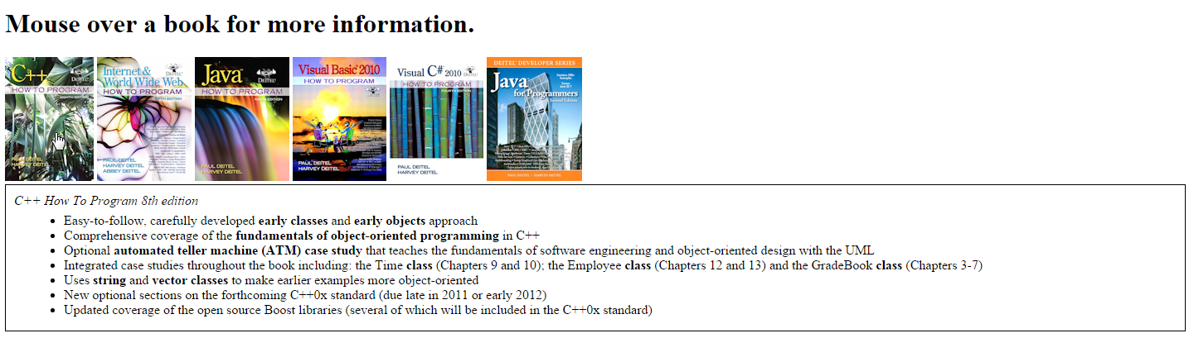
“Raw” Ajax Example Using the XMLhttpRequest Object

Slide 56
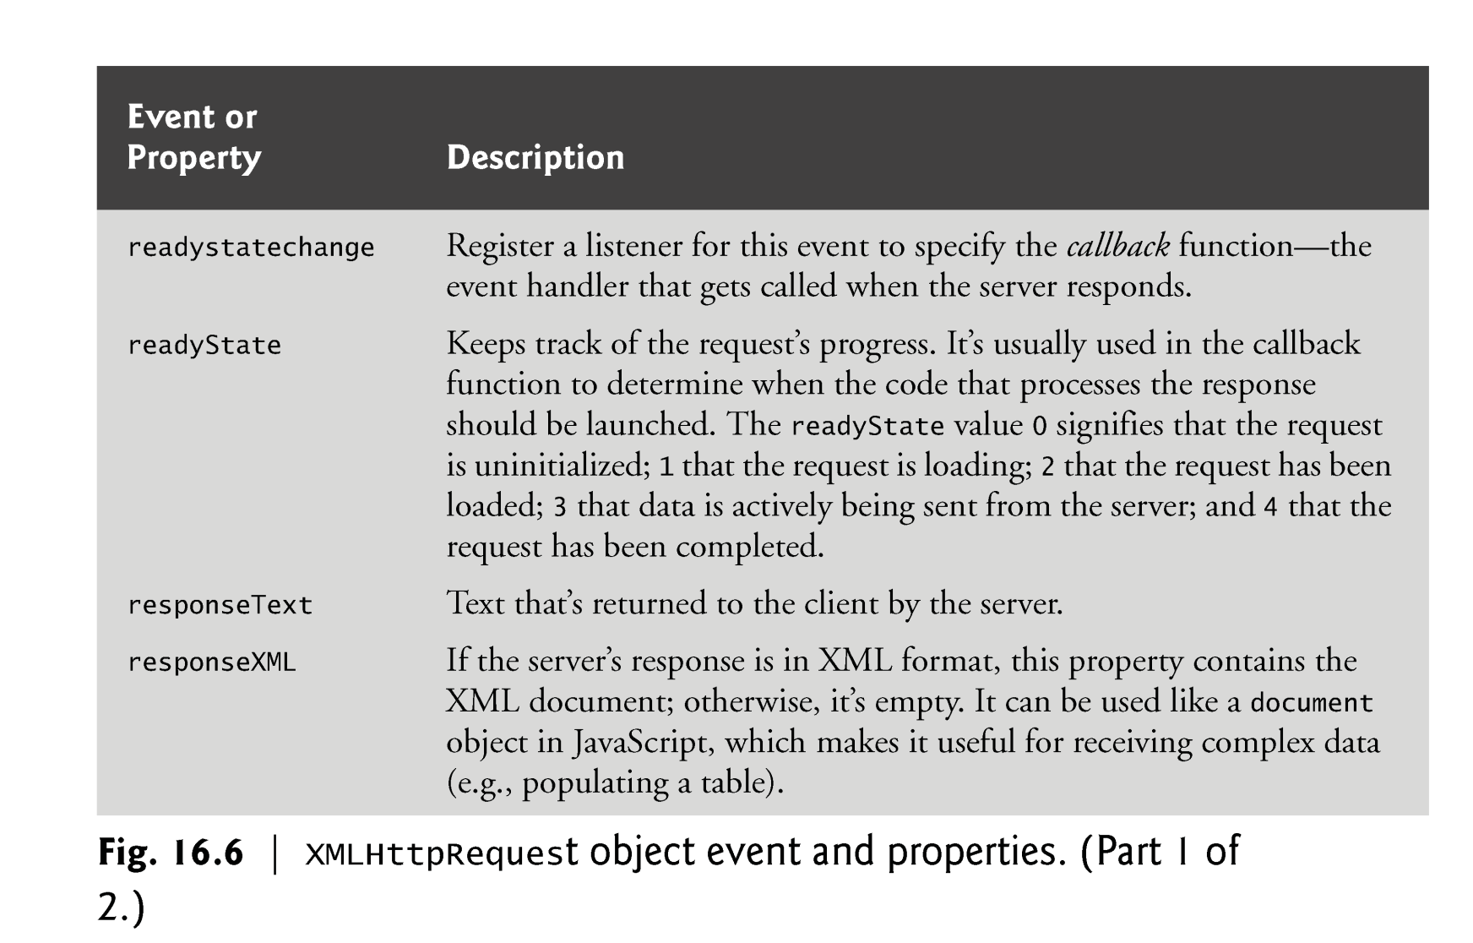
XMLHttpRequest object

Slide 57
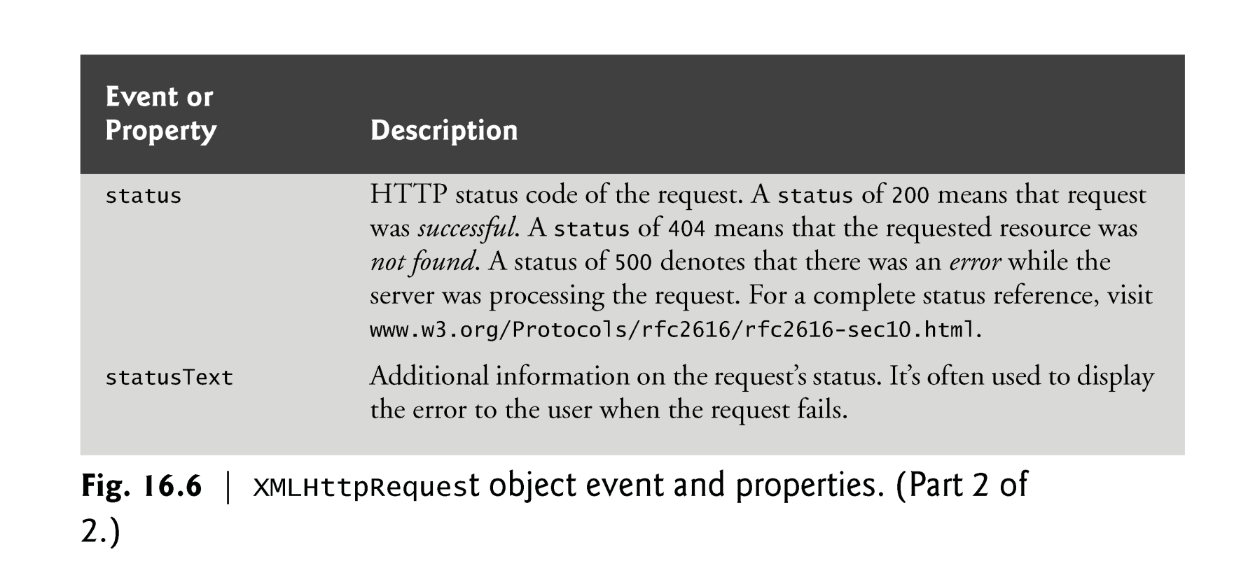
XMLHttpRequest object

Slide 58
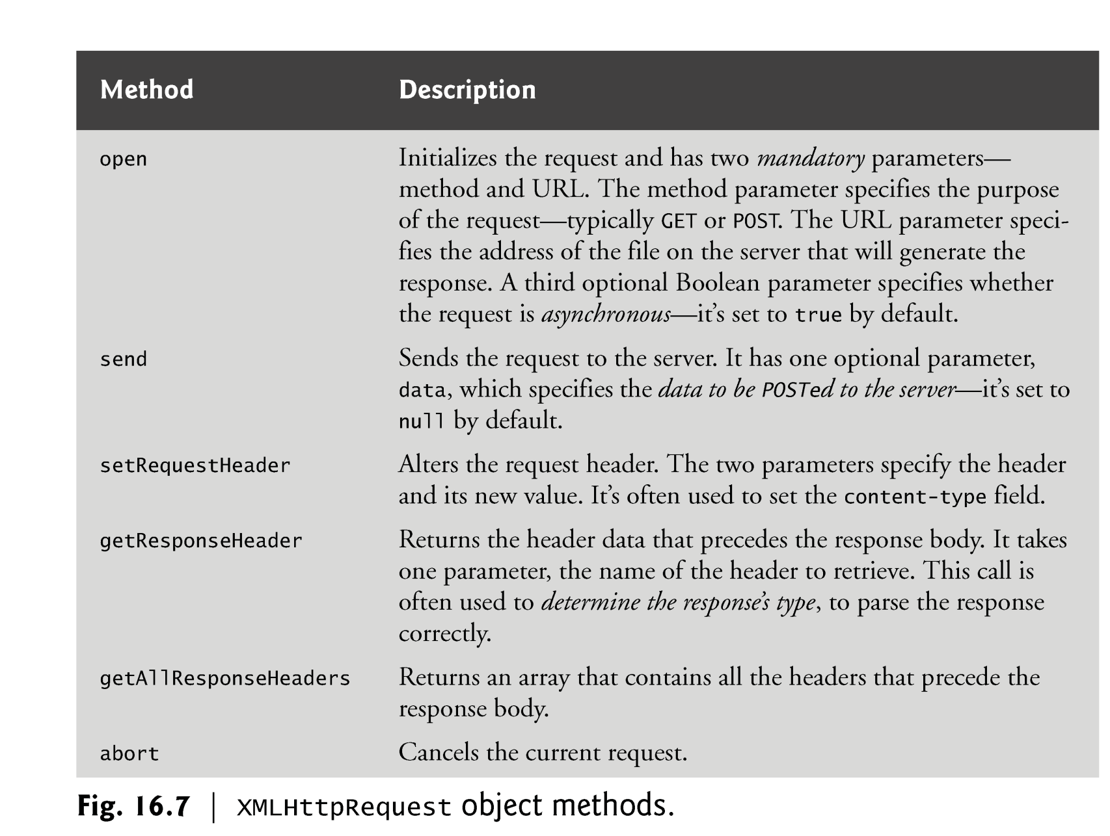
XMLHttpRequest object

Slide 59
XML
<!DOCTYPE html>
<html>
<head>
<meta charset="utf-8">
<title> Pulling Images onto the Page </title>
<style type = "text/css">
li { display: inline-block; padding: 4px; width: 120px; }
img { border: 1px solid black }
</style>
<script>
var asyncRequest;
function getImages( url )
{
try
{
asyncRequest = new XMLHttpRequest();
asyncRequest.addEventListener("readystatechange", processResponse, false);
asyncRequest.open( "GET", url, true );
asyncRequest.send( null );
}
catch ( exception )
{
alert( "Request Failed" );
}
}

Slide 60
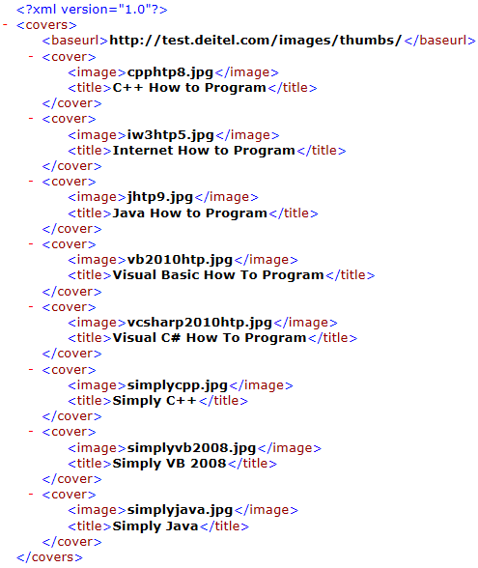
XML
item(0)
item(1)
item(2)
item(3)
function processResponse()
{
if ( asyncRequest.readyState == 4 && asyncRequest.status == 200 && asyncRequest.responseXML )
{
clearImages();
var covers = asyncRequest.responseXML.getElementsByTagName("cover");
var baseUrl = asyncRequest.responseXML.getElementsByTagName("baseurl").item( 0 ).firstChild.nodeValue;
var output = document.getElementById( "covers" );
var imagesUL = document.createElement( "ul" );
for ( var i = 0; i < covers.length; ++i )
{
var cover = covers.item( i );
var image = cover.getElementsByTagName( "image" ).item( 0 ).firstChild.nodeValue;
var imageLI = document.createElement( "li" );
var imageTag = document.createElement( "img" );
imageTag.setAttribute( "src", baseUrl + escape( image ) );
imageLI.appendChild( imageTag );
imagesUL.appendChild( imageLI );
}
output.appendChild( imagesUL );
}
}

Slide 61
XML
function clearImages()
{
document.getElementById( "covers" ).innerHTML = "";
}
function registerListeners()
{
document.getElementById( "all" ).addEventListener("click",
function() { getImages( "all.xml" ); }, false );
document.getElementById( "simply" ).addEventListener("click",
function() { getImages( "simply.xml" ); }, false );
document.getElementById( "howto" ).addEventListener("click",
function() { getImages( "howto.xml" ); }, false );
document.getElementById( "dotnet" ).addEventListener("click",
function() { getImages( "dotnet.xml" ); }, false );
document.getElementById( "javaccpp" ).addEventListener("click",
function() { getImages( "javaccpp.xml" ); }, false );
document.getElementById( "none" ).addEventListener("click", clearImages, false );
}
window.addEventListener( "load", registerListeners, false );
</script>
</head>

Slide 62
XML
<body>
<input type = "radio" name ="Books" value = "all" id = "all"> All Books
<input type = "radio" name = "Books" value = "simply" id = "simply"> Simply Books
<input type = "radio" name = "Books" value = "howto" id = "howto"> How to Program Books
<input type = "radio" name = "Books" value = "dotnet" id = "dotnet"> .NET Books
<input type = "radio" name = "Books" value = "javaccpp" id = "javaccpp"> Java/C/C++ Books
<input type = "radio" checked name = "Books" value = "none" id = "none"> None
<div id = "covers"></div>
</body>
</html>

Slide 63
XML
Ref: http://www.w3schools.com/xml/dom_element.asp
firstChild Property
returns the first child node of the selected element
childNodes Property
Returns a NodeList of child nodes for the element
var covers = asyncRequest.responseXML.getElementsByTagName("cover");
for ( var i = 0; i < covers.length; ++i )
{
var cover = covers.item( i );
var image = cover.getElementsByTagName( "image" ).item( 0 ).firstChild.nodeValue;
}
clildNodes[0]
covers.item(0)
covers.item(1)
covers.item(2)

Slide 64
JSON
<!DOCTYPE html>
<html>
<head>
<meta charset = "utf-8">
<title>Sample JSON Query</title>
<script>
var asyncRequest;
function progress()
{
try
{
asyncRequest = new XMLHttpRequest();
asyncRequest.addEventListener("readystatechange", processResponse, false);
asyncRequest.open( "GET", "AQX.json", true );
asyncRequest.send( null );
}
catch ( exception )
{
alert( "Request Failed" );
}
}

Slide 65
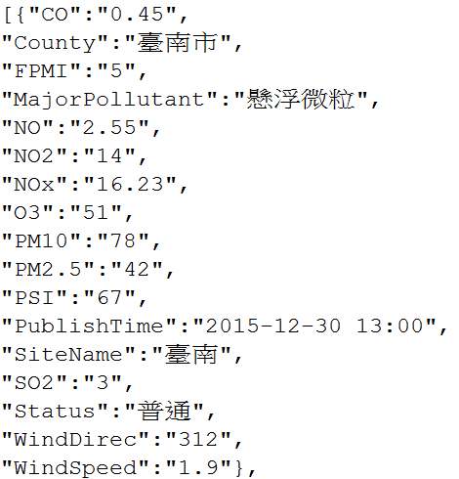
JSON
function processResponse()
{
if ( asyncRequest.readyState == 4 && asyncRequest.status == 200 )
{
var output = document.getElementById( "out" );
var data = JSON.parse(asyncRequest.responseText);
var aq = document.getElementById( "aqindex" ).value;
for (var i = 0;i<data.length;i++)
{
var row = document.createElement( "tr" );
var station = document.createTextNode(data[i]["SiteName"]);
var value = document.createTextNode(data[i][aq]);
var c1 = document.createElement( "td");
c1.appendChild(station);
row.appendChild( c1);
var c2 = document.createElement( "td");
c2.appendChild(value);
row.appendChild( c2);
output.appendChild( row );
}
}
}
</script>

